Slide 1

International Airports Guide for Dummies 101
Isabel Bueschel, Grace Chan, Noreen Malik, Rene Venema
GLOBAL NOMAD

Slide 2
In the beginning
What to do?? What to do??
-Flowers and revenues across the US
No good data sets. Unclear data. Late response
-Restaurants Use Zomato API
API was horrible.
-Travel Data
Leading somewhere
DID NOT WORK!!!

Slide 3
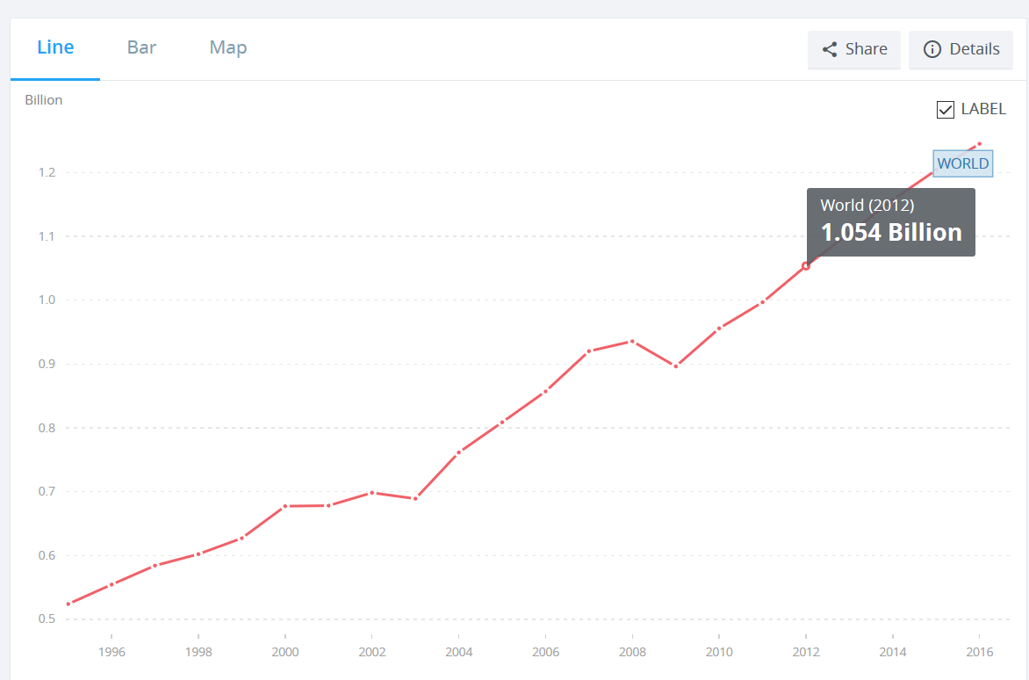
International Tourism: Number of Arrivals

Slide 4
Finally….
Came up with the idea for an interactive leaflet application showing touristic info within the vicinity of airports across the world.
Zoomed in on top 100 airports having highest volume of passengers
Used Google Places API to create overview of nearby food, lodging and services within 50 kilometers

Slide 5
Data
Airport Json
Top 100 Airports CSV
Google places API

Slide 6
What we did…
Created dictionary latitude, longitude, airports
Merged Airport JSON with top 100 Busiest Airports
Google API = Bar, bus stations, car rentals, embassy, lodgings, museum, night club, restaurant, subway stations, taxi stand, train station, transit station

Slide 7
THE RESULT !

Slide 8
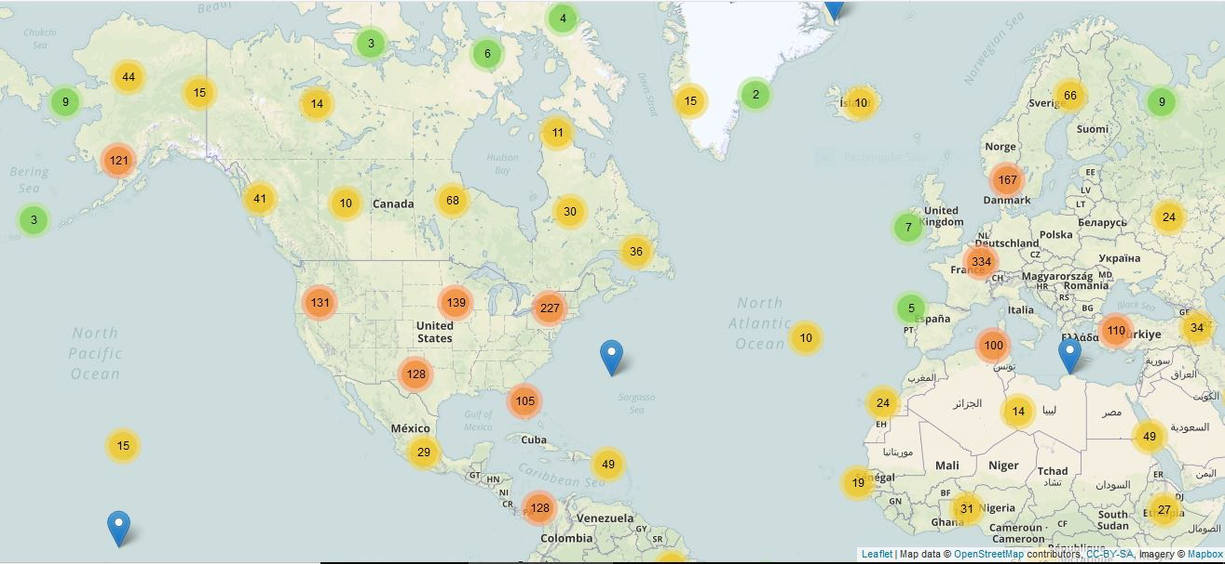

Slide 9


Slide 10
Issues/Concerns
Time
Google places API
API limit= 1000 calls per/24 hours
50 calls/sec
Changed scope from all airports to top 100 airports

Slide 11
More Time…
Get data for all airports
Rank the searches …(Ex Most expensive restaurants, highest ranked hotels)
Filter for more user interaction
Incorporate countries travel traffic.
Locations inside the airport
Web Scraping (http://www.airporthotelguide.com/all-airports.html)

Slide 12
THANK YOU!!
Q and A

